Slide 1
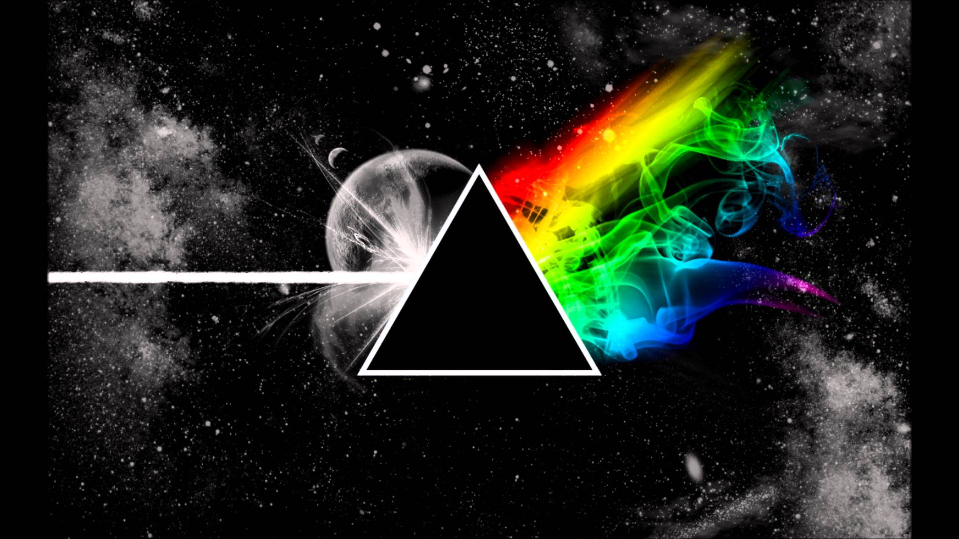
Spectrum
Sam Van Cise, Julian Contreras, Marshall Craft, Patrick Lowe, Isaac Rosado, Samuel Inman, Alex Markovits

Slide 2
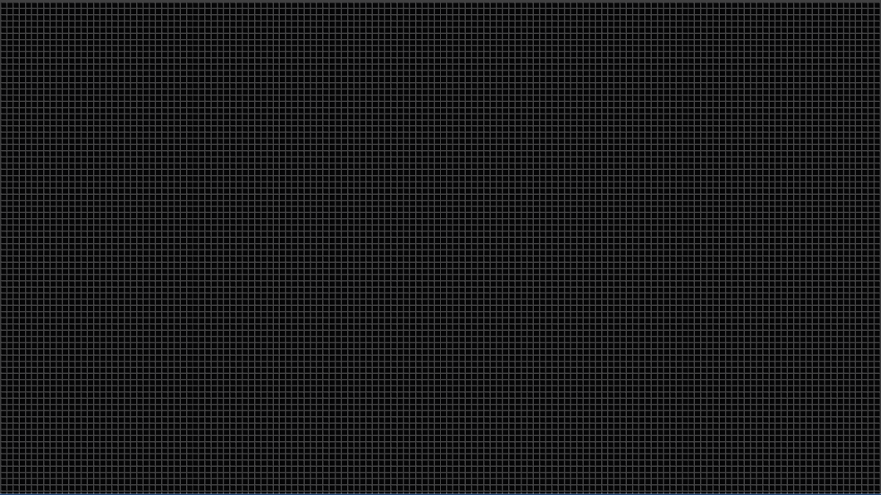
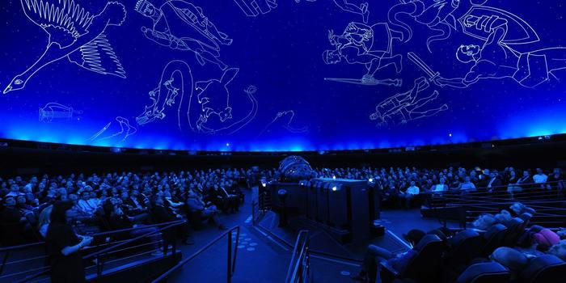
Big and Small
Large audience with 1 big screen
Mass Interactivity

Slide 3
Gameplay
Notes:
Players:
Commentators:

Slide 4
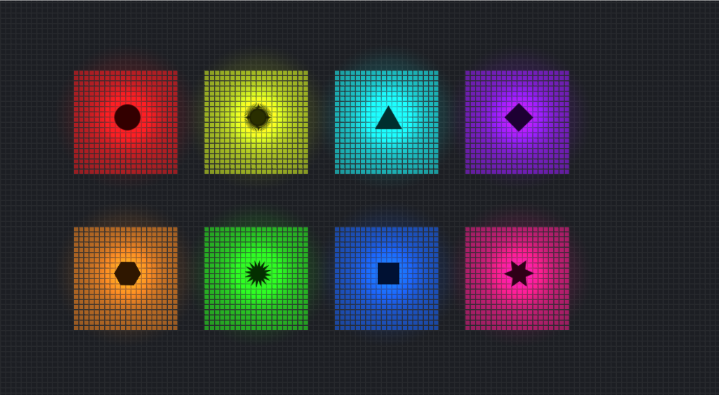
Design Decisions

Slide 5
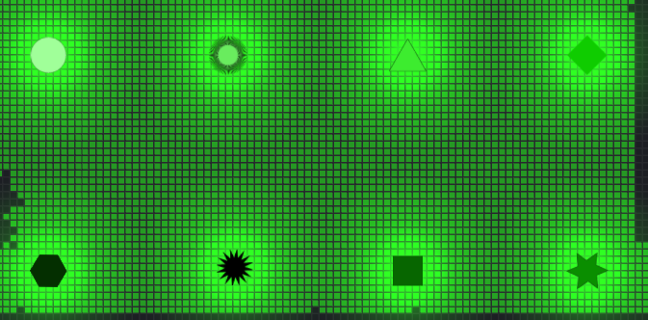

Slide 6
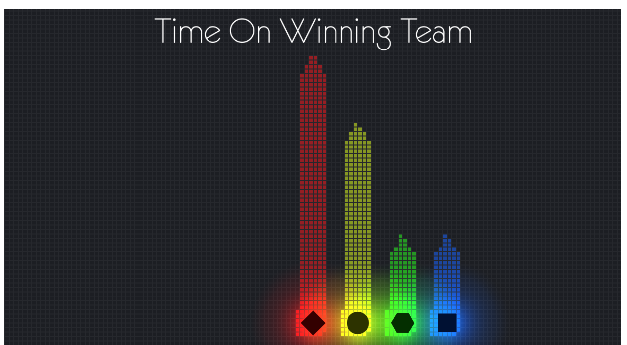
Score System
Screen capture of the scoreboard
Score system

Slide 7
Networking
Uses existing unity plugin (Photon)
Photon internally uses client-server model
Game display machine handshakes with players to start game
Game display machine runs the game while the phones act as controllers
Controllers merely relay input to the main machine
controllers
Game display
Notes:
Who needs notes

Slide 8
What Went Right
Unity engine made our lives easier (Asset Store)
Strong prototyping -> unified vision
Started with prototype Sam made in 8 hours
Xbox controllers and phones developed in parallel
Dropped Xbox controllers ⅔ of the way through
Good delegation and division of responsibilities
Testing early proved concept and understanding of deeper strategies

Slide 9
What Went Wrong
Didn’t decide a target audience
Debugging limited to certain situations
During class
During focus test
Decided a control scheme with the wrong controller
Originally Xbox and keyboard
Added phone three weeks in

Slide 10
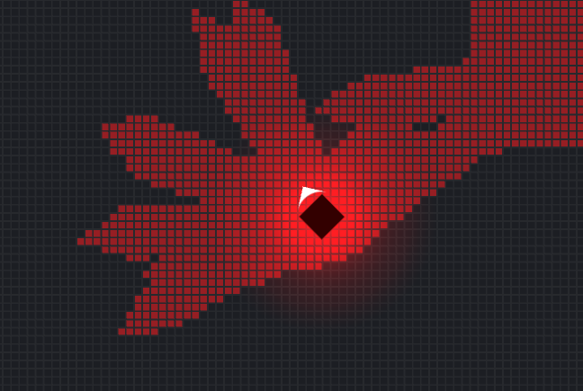
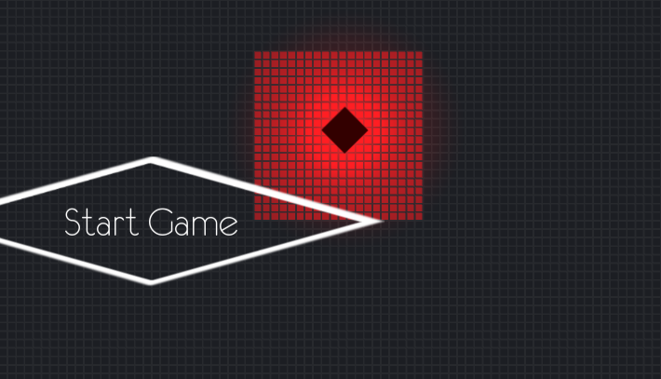
What Went Wrong
Audiences unfamiliar with joysticks had unexpected difficulty with the game

Slide 11
Takeaways
Networking is tough. Added layers of complexity.
Notes:
There isn’t another project in this class, but the skills we’ve learned in this class generally apply to all other projects in the real world. Here are our specific takeaways from this project.
As Julian alluded to, networking is difficult. Even with a well-established engine like Photon there is still a whole other layer of complexity added. We mitigated this complexity by always having a local version of our game for testing and not addressing the more complex scenarios that could occur with players leaving and reentering.
There’s always a struggle in testing that the tester is distracted by unpolished aspects of your game. While fellow developers can relate, non-developers will wonder why the sprites aren’t prettier at this moment. We especially felt that focus testing in this project. Furthermore we had the most trouble focus testing with gamers because they know what to look for in terms of polish, but that can distract them from the concrete questions you want them to answer like does the scoring system make sense.
The real lessons of this class, especially for those of us not going into the game industry, are about project management processes. All things considered, we did very well with implementing the scrum style processes we’ve learned. While we didn’t always update the changelogs and tasklists in a timely manner, we delegated well and kept lines of communication very open, and that proved more important.

Slide 12
Takeaways
Non-developer testers require a lot more polish to concentrate on the gameplay. Especially non-developer gamers. Surprising!

Slide 13
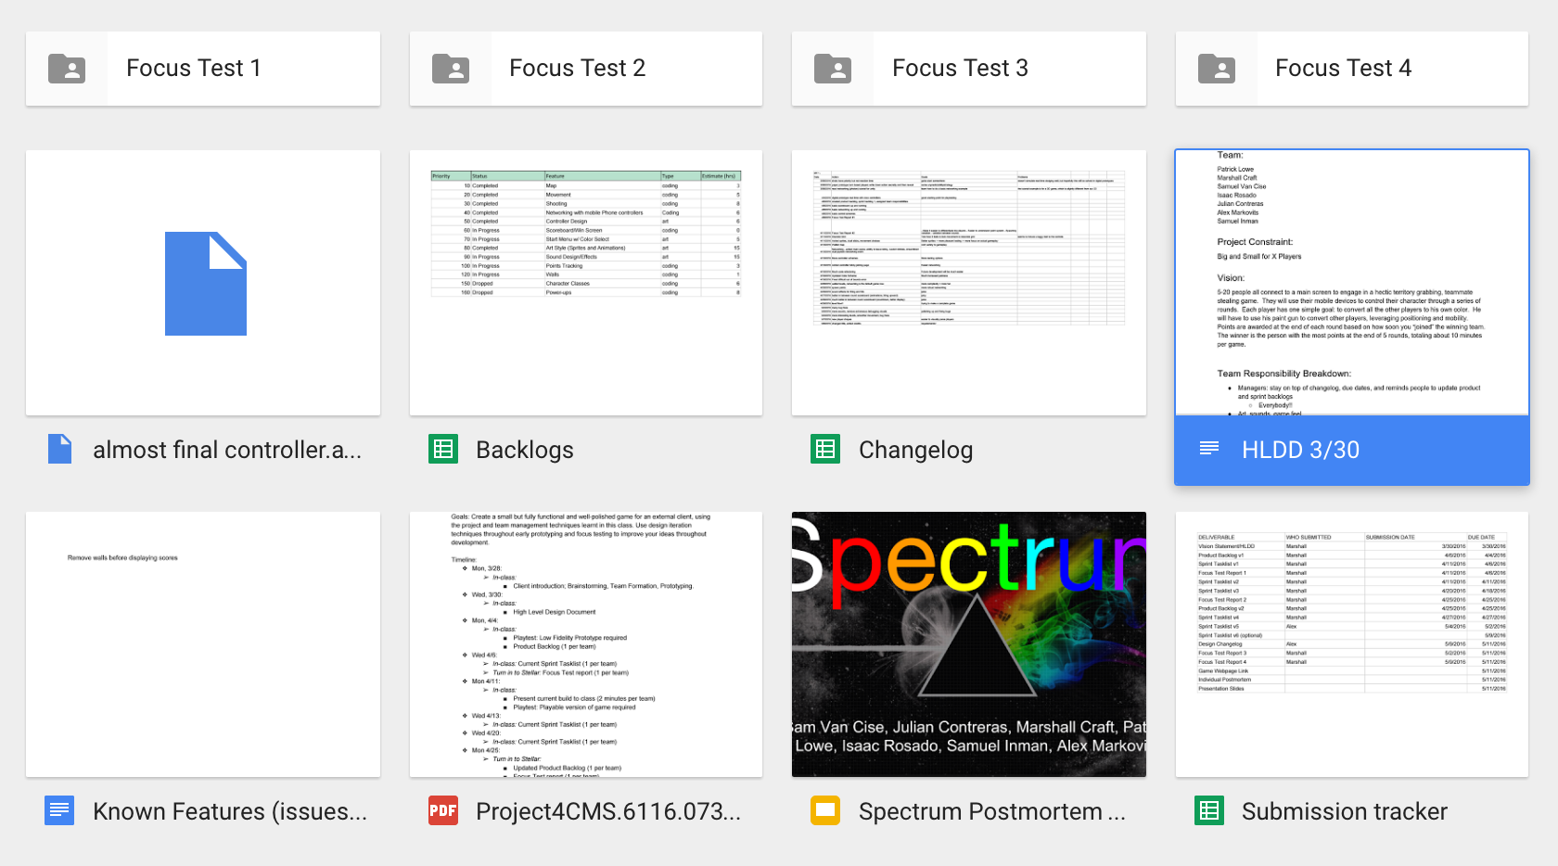
Takeaways
Consistent communication (email) and a centralized view of progress (i.e. scrums) were very helpful

Slide 14
Questions?

